Slide 1
5. Deductive reasoning
John P. McCrae
CT5166

Slide 2
Course structure
9th Sep | Introduction to Knowledge Graphs | 21st Oct | Inductive reasoning
16th Sep | Models for Knowledge Graphs | 28th Oct | KG Creation (no lab on Monday)
23rd Sep | Querying and Serialization | 4th Nov | KG Alignment
30th Sep | Schemas | 11th Nov | Publishing and Linked Open Data
7th Oct | Deductive reasoning | 18th Nov | Linguistic Linked Open Data
14th Oct | No Lecture | 25th Nov | Enterprise Knowledge Graphs

Slide 3
RDFS Rule Summary
x type y | y subClassOf z | x type z
x subClassOf y | y subClassOf z | x subClassOf z
x p y | p subPropertyOf q | x q y
x subPropertyOf y | y subPropertyOf z | x subProperty z
x p y | p domain z | x type z
x p y | p range z | y type z

Slide 4
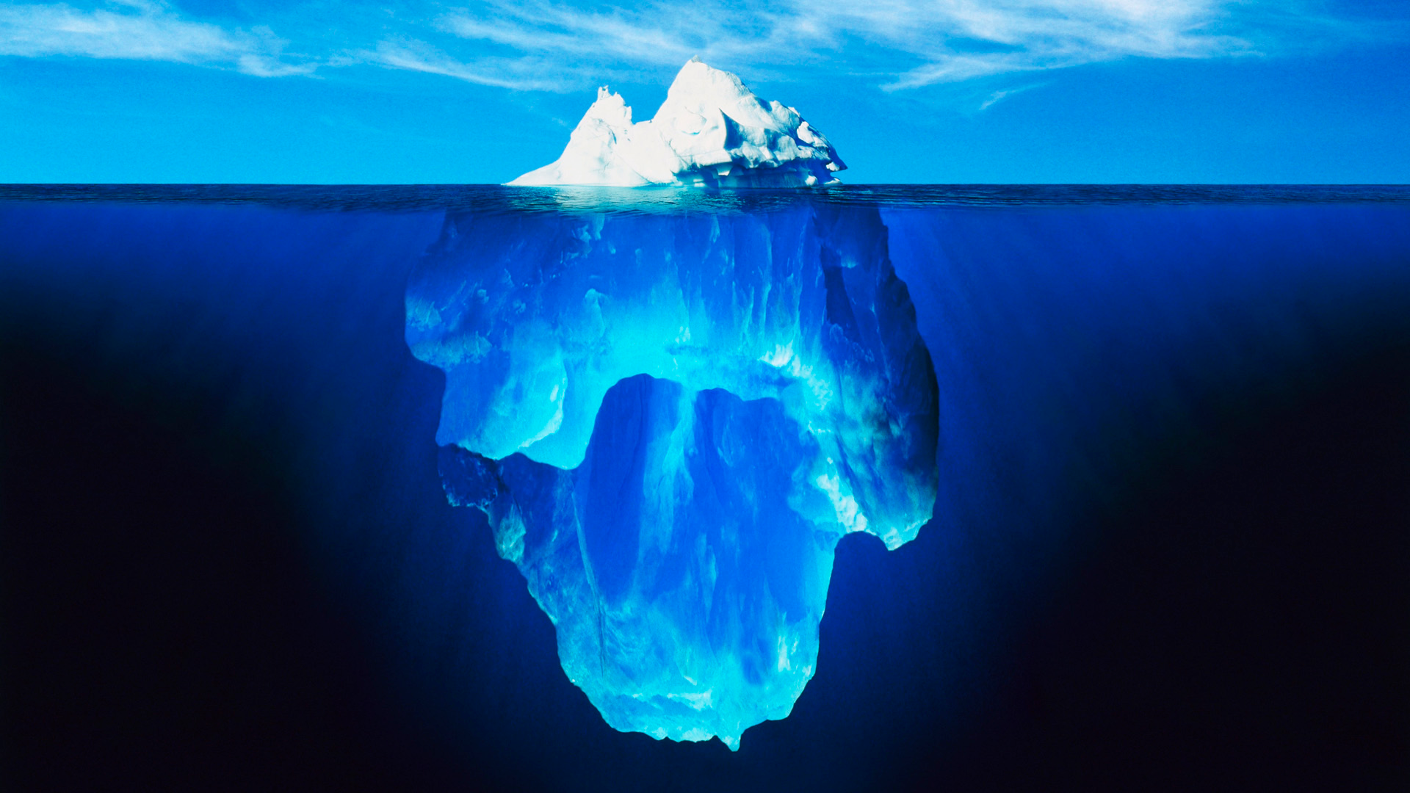



Slide 5
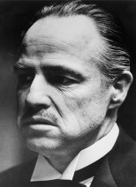
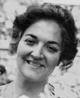

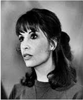
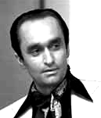
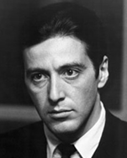

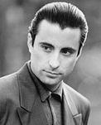

A special family...
ex:Vito
ex:Carmela
ex:Sonny
ex:Connie
ex:Fredo
ex:Michael
ex:Vincent
ex:Mary

Slide 6
Open World Assumption
How many children
does Vito have according to this RDF?
4
ex:Vito
At least 4
:hasChild
ex:Connie
ex:Sonny
ex:Fredo
ex:Michael

Slide 7
Open World Assumption
Nothing is false (or true) unless it is stated to be
Opposite is ‘closed world assumption’ or ‘negation by failure’
What are some advantages/disadvantages of the OWA?

Slide 8
No Unique Name Assumption
How many children
does Vito have according to this RDF?
Vito has 4 children?
Vito has at least 4 children?
Vito has at least one child!
ex:Vito
:hasChild
ex:Connie
ex:Sonny
ex:Fredo
ex:Michael

Slide 9
No Unique Name Assumption
RDF(S) and OWL:
Take an Open World Assumption:
Anything not known is not assumed to be false, simply unknown
Without further information, Vito may have children that we don’t know about!
Do not take a Unique Name Assumption:
Two or more URIs may refer to the same thing!
Without further information, the URIs we know to be Vito’s children may refer to one thing in the real-world!

Slide 10
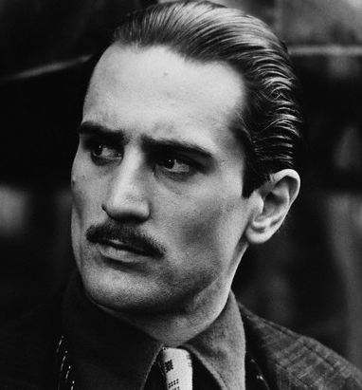
Asserting equality
WARNING:
Do not use owl:sameAs for classes and properties!
owl:sameAs
owl:sameAs
ex:VitoOld
Vito
ex:VitoYoung
:hasGrandson
:granddaugtherOf
:hasGrandson
:granddaugtherOf
ex:VitoOld owl:sameAs ex:VitoYoung .
ex:Vincent
ex:Mary

Slide 11
Asserting inequality
ex:Vito
:hasChild
ex:Connie
ex:Sonny
ex:Fredo
ex:Michael
owl:differentFrom

Slide 12
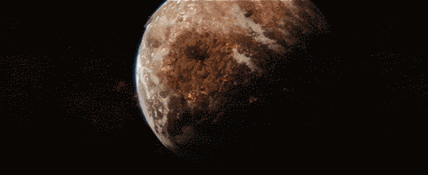
Inconsistency
owl:sameAs
owl:differentFrom
ex:VitoOld
ex:VitoYoung

Slide 13
Equivalent Properties
:parentOf
:hasChild
:hasChild
:parentOf
ex:Vito
ex:Michael
ex:Mary
ex:Vito :parentOf ex:Michael .
ex:Michael :hasChild ex:Mary .
:parentOf owl:equivalentProperty :hasChild .
⇒ ex:Vito :hasChild ex:Michael .
⇒ ex:Michael :parentOf ex:Mary .
owl:disjointPropertyWith asserts properties are never equivalent

Slide 14
Inverse properties
:parentOf
:childOf
:childOf
:parentOf
ex:Carmela
ex:Sonny
ex:Vincent
ex:Carmela :parentOf ex:Sonny .
ex:Vincent :childOf ex:Sonny .
:parentOf owl:inverseOf :childOf .
⇒ ex:Sonny :parentOf ex:Vincent .
⇒ ex:Sonny :childOf ex:Carmela .

Slide 15
Symmetric Properties
:sibling
:sibling
ex:Connie
ex:Fredo
ex:Connie :sibling ex:Fredo .
:sibling rdf:type owl:SymmetricProperty .
⇒ ex:Fredo :sibling ex:Connie .
Functions can also be ‘asymetric’

Slide 16
Transitive Properties
:ancestorOf
:ancestorOf
ex:Carmela
ex:Michael
ex:Mary
:ancestorOf
ex:Carmela :ancestorOf ex:Michael .
ex:Michael :ancestorOf ex:Mary .
:ancestorOf rdf:type owl:TransitiveProperty .
⇒ ex:Carmela :ancestorOf ex:Mary .

Slide 17
Task
What inference rules can be used for equivalent, inverse, symmetric & transitive properties?

Slide 18
Reasoning

Slide 19
Interpretations
Knowledge Graph
airport
London
Heathrow
Real World
London
airport
Heathrow

Slide 20
Interpretations
Could this interpretation be consistent with a knowledge graph?
Not under the closed world assumption
Under the open world assumption, possibly
There are many interpretations of a KG
Knowledge Graph
Real World
Galway
airport
Heathrow

Slide 21
Entailment
An model is a graph that interprets another graph
If all models of G₁ are also a model of G₂, then we say that G₁ entails G₂
Entailment in general is not decidable for first-order logic

Slide 22
Materialization
locatedIn
Co. Galway
locatedIn
Tuam
Ireland
locatedIn
locatedIn a TransitiveProperty
Materialization adds new triples to the graph as needed
Very inefficient
Infinite number of new triples can be inferred in some schemes

Slide 23
Query Rewriting
Is Tuam in Ireland?
Is Tuam located in a place that is located in Ireland?
Doesn’t need everything to be materialized
Still very hard to implement efficiently

Slide 24
Description logics
Subset of first-order logic that allows for decidable reasoning
Models classes with a Terminology Box or T-Box
Models properties with a Relation Box or R-Box
Models individuals with an Assertional Box or A-Box
OWL is closely modelled on description logics

Slide 25
Advanced OWL Features

Slide 26
Property Chains (OWL 2.0)
:brotherOf
:fatherOf
ex:Sonny
ex:Michael
ex:Mary
:uncleOf
ex:Sonny :brotherOf ex:Michael .
ex:Michael :fatherOf ex:Mary .
:uncleOf owl:propertyChainAxiom (:brotherOf :fatherOf) .
⇒ ex:Sonny :uncleOf ex:Mary .

Slide 27
Reflexive Properties
:similarTo
:similarTo
ex:Connie
ex:Fredo
:similarTo rdf:type owl:ReflexiveProperty .
⇒ ex:Connie :similarTo ex:Connie .
ex:Freddie :similarTo ex:Freddie .
(everything :similarTo itself)
Functions can also be ‘irreflexive’

Slide 28
Functional Property
:hasFather
Cardinality of property. At most one subject.
Can also be inverse functional (at most one object).
ex:Fredo
ex:Vito
ex:VitoYoung
ex:VitoOld
ex:Fredo :hasFather ex:VitoOld .
ex:Fredo :hasFather ex:VitoYoung .
:hasFather rdf:type owl:FunctionalProperty .
⇒ ex:VitoOld owl:sameAs ex:VitoYoung .

Slide 29
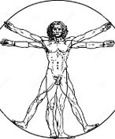

Equivalent Classes
rdf:type
rdf:type
:Human
rdf:type
rdf:type
ex:Vincent
ex:Mary
:Person
ex:Vincent rdf:type :Human .
ex:Mary rdf:type :Person .
:Human owl:equivalentClass :Person .
⇒ ex:Vincent rdf:type :Person .
ex:Mary rdf:type :Human .

Slide 30


Disjoint Classes
ex:DonCorleone
ex:LawAbiding
rdf:type
rdf:type
ex:Vincent
ex:Vincent rdf:type ex:DonCorleone , ex:LawAbiding .
ex:DonCorleone owl:disjointWith ex:LawAbiding .
⇒ FALSE

Slide 31
Task
How to model mobile phones?
What properties might you introduce? Try to find one example of each of the topics in the slides!

Slide 32


Unions
≡
⊔
:Person
:Woman
:Man
rdf:type
ex:Vincent
rdf:type
ex:Vincent rdf:type :Man .
:Person owl:equivalentClass [ owl:unionOf ( :Woman :Man ) ]
⇒ ex:Vincent rdf:type :Person .

Slide 33


Intersections
≡
⊓
:Mother
:Female
:Parent
rdf:type
rdf:type
rdf:type
ex:Carmela
ex:Carmela rdf:type :Female , :Parent .
:Mother owl:equivalentClass [ owl:intersectionOf ( :Female :Parent ) ]
⇒ ex:Carmela rdf:type :Mother .

Slide 34


Complements
≡
¬
:Dead
:Alive
¬rdf:type
rdf:type
ex:Mary rdf:type :Alive .
:Dead owl:equivalentClass [ owl:complementOf :Alive ]
⇒ [] owl:sourceIndividual ex:Mary ; owl:targetProperty rdf:type ; owl:targetIndividual :Dead .
ex:Mary

Slide 35
One-of
≡
{
}
,
,
:DonCorleone
ex:Vito
ex:Michael
ex:Vincent
rdf:type
rdf:type
rdf:type
:DonCorleone owl:equivalentClass
[ owl:oneOf (ex:Vito ex:Michael ex:Vincent) ]
⇒ ex:Vito rdf:type :DonCorleone .
⇒ ex:Michael rdf:type :DonCorleone .
⇒ ex:Vincent rdf:type :DonCorleone .

Slide 36
All values from
⊑
∀
:hasParent.
:Person
:Person
rdf:type
rdf:type
:hasParent
ex:Mary rdf:type :Person ; :hasParent ex:Michael .
:Person rdfs:subClassOf
[ owl:allValuesFrom :Person ; owl:onProperty :hasParent ]
⇒ ex:Michael rdf:type :Person .
ex:Mary
ex:Michael

Slide 37
Some Values From
≡
∃
:hasChild.
:Parent
:Person
rdf:type
rdf:type
:hasChild
ex:Carmela
ex:Michael
ex:Carmela :hasChild ex:Michael . ex:Michael rdf:type :Person .
:Parent owl:equivalentClass
[ owl:someValuesFrom :Person ; owl:onProperty :hasChild ]
⇒ ex:Carmela rdf:type :Parent .

Slide 38
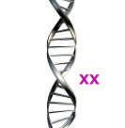
Has Value
≡
∃
{
}
:hasDNA.
:Female
:XX
rdf:type
:hasDNA
ex:Carmela
ex:Carmela :hasDNA :XX .
:Female owl:equivalentClass
[ owl:hasValue :XX ; owl:onProperty :hasDNA ]
⇒ ex:Carmela rdf:type :Female .

Slide 39
Cardinality
Define a class with a given number of values for a property:
Exact:
:Person ⊑ = 2 (:hasParent)
:Parent rdfs:subClassOf [ owl:cardinality 2 ; owl:onProperty :hasParent ] .
Max:
:Monogamist ⊑ ≤ 1 (:currentSpouse)
:Monogamist rdfs:subClassOf [ owl:maxCardinality 1 ; owl:onProperty :currentSpouse ] .
Min:
:Parent ≡ ≥ 1 (:hasChild)
:Parent owl:equivalentClass [ owl:minCardinality 1 ; owl:onProperty :hasChild ] .

Slide 40
Task
Can you update your mobile phone modelling with any further axioms?

Slide 41
Summary
OWL
Many axioms.
Can always be solved (decidable) but not always easily (tractable)
Does this make sense for web data?

